Slide 1
How does the web works?
The web is based on the idea of ’hypertext’. This implies that texts can be embedded inside other texts, perhaps to provide fuller explanations or background material. Web pages can also embed multimedia, so that, for example, clicking the word ‘cello’ could play some cello music.
Web pages are written in text with Hypertext Markup Language (HTML), then uploaded to a host computer running web server software, such as Apache or Microsoft’s IIS (Internet Information Server).
The web server sends out pages when they are requested by a web browser, such as Microsoft Internet Explorer, Mozilla Firefox or Google Chrome. The host and client communicate using an agreed ’language’ called HTTP (HyperText Transfer Protocol). This is why web page addresses begin with http:// and so on.

Slide 2
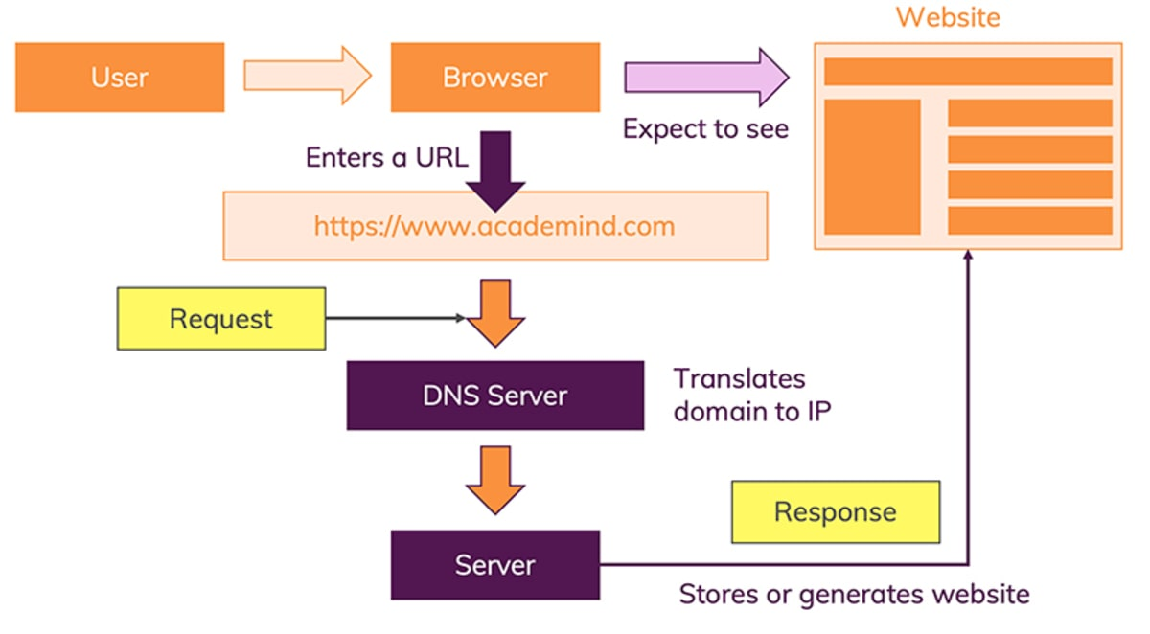

Slide 3
What do you need to be a web developer?
While there are no formal or specific qualifications required to become a web developer, a numerate degree in a subject such as maths or science will be useful.
You should also ideally have an aptitude for - or experience of - elements such as:
User experience (UX)
User interface (UI)
Visual design
Coding languages including HTML and CSS
Frontend web programing languages and skills such as JavaScript, Ajax and web animation techniques
Backend web programing languages such as C# or Java, PHP and Ruby
Design software like Photoshop and Illustrator and Sketch
An understanding of SEO
Web servers and how they function
Key skills to be successful in web development include:
Computer literacy
Strong numeracy skills
Strong creative ability
Attention to detail
Strong communication skills
Excellent problem-solving skills
A logical approach to work
The ability to explain technical matters clearly
A keen interest in technology
Ongoing self-learning is key to developing in a web development role, in order to stay up to date with ever more frequent technological advancements and updates.

Slide 4
What’s the role of a web developer
A web developer is responsible for programming the code that “tells” a website how to function. A developer builds a website from the bottom up, which means designing it in such a way that end users have no difficulty navigating the site
A web developer builds and maintains websites with the client and consumer in mind.
Web developers are familiar with technology and understand how computers and web servers operate. They are also very familiar with many software programs, web applications and web programming languages, such as hypertext markup language (HTML), JavaScript (JS), Ruby on Rails, and C++. They must be able to communicate effectively, set goals and meet deadlines.

